Slide 1
Temporal Expression and Event Extraction using General Conditional Random Fields
An Experimental Evaluation
Presented by Ankush Israney & Jaidev Ramakrishna for CS 613

Slide 2
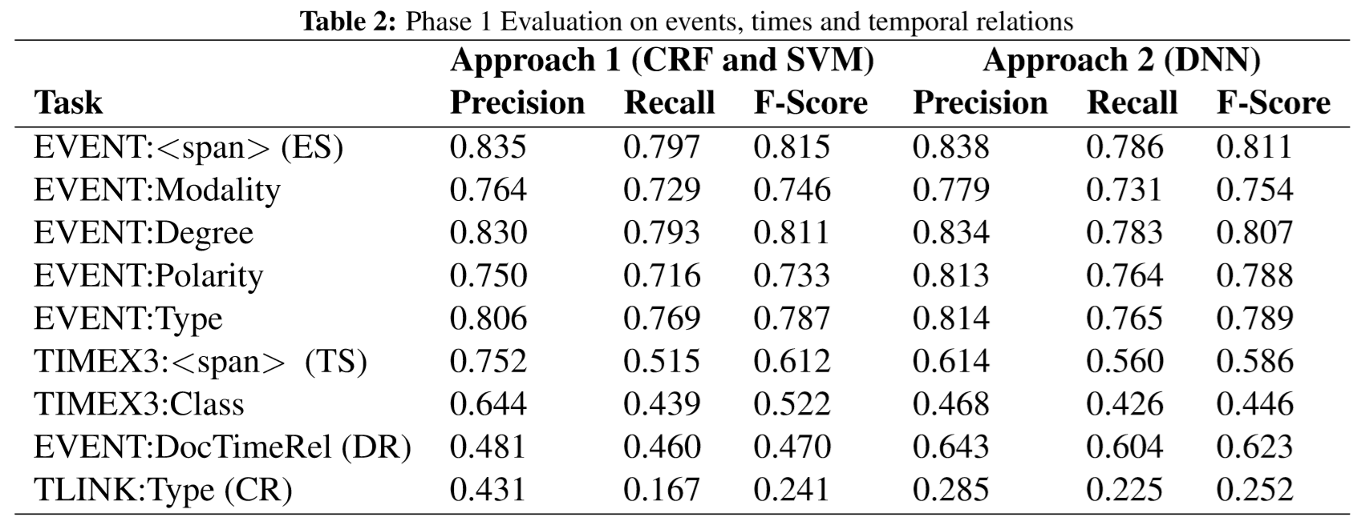
Original Objectives
Our initial proposal considered the usage of a Deep Neural Network to extract events and temporal expressions.
We found recent research with an identical line of inquiry.
V.R Chikka claims in “Extraction of Temporal Information from Clinical documents using Machine Learning techniques” :- “The results show that both approaches (give) relatively same performance on the provided train and test datasets of the challenge.”

Slide 3
Project Objectives
Many researchers have produced statistical results in favor of employing Machine Learning techniques in the following tasks of the TempEval Competition Series.
Time span (TS) identification
Event span (ES) identification
Therefore, we use CRF classifiers to extract events and temporal expressions in the News domain. (TempEval3 – 2013 publicly available dataset)
Additionally, we perform a detailed quantitative and qualitative analysis of these tasks.
We have built an extensible system that integrates existing NLP frameworks, which can be used on a variety of domains (annotated in TimeML).

Slide 4
Conditional Random Fields
CRFs are a type of discriminative undirected probabilistic graphical model. It is used to encode known relationships between observations and construct consistent interpretations. (Sounds like HMM!, but different – conditioned on input and features)
Popular for pattern recognition tasks, especially Named Entity Recognition in NLP.
CRF’s exploit the concept of Feature Functions:
1 feature for each state transition and a 1 feature for each state-observation pair.
Important Distinction from generative models like HMM (Discriminative: More like logistic regression here, Is that why it performs like DNN?)
In it’s most intuitive explanation, In the NER task, the label for a word may not depend on its previous word but could be relevant to any word in the sentence.

Slide 5

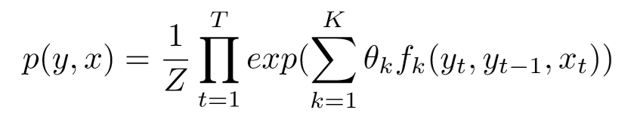
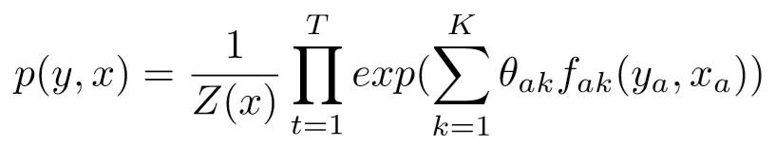
Conditional Random Fields
Feature function
Linear CRF
General CRF

Slide 6
Input Features
useClassFeature - Include a feature for the class (as a class marginal). Puts a prior on the classes which is equivalent to how often the feature appeared in the training data.
useWord= Gives Feature for w
useNGrams - Make features from letter n-grams, i.e., substrings of the word
noMidNGrams - Do not include character n-gram features for n-grams that contain neither the beginning or end of the word
maxNGramLeng - If this number is positive, n-grams above this size will not be used in the model
usePrev - Gives you feature for (pw,c), and together with other options enables other previous features, such as (pt,c) [with useTags)
useNext - Gives you feature for (nw,c), and together with other options enables other next features, such as (nt,c) [with useTags)

Slide 7
Input Features
useDisjunctive - Include in features giving disjunctions of words anywhere in the left or right disjunctionWidth words (preserving direction but not position)
useSequences - Does not use any class combination features if this is false
usePrevSequences - Does not use any class combination features using previous classes if this is false
useTypeSeqs - Use basic zeroeth order word shape features.
useTypeSeqs2 - Add additional first and second order word shape features
useTypeySequences - Some first order word shape patterns.
wordShape - Either "none" for no wordShape use, or the name of a word shape function.

Slide 8
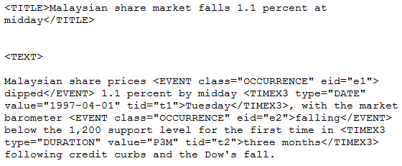
Data Sets and Preprocessing
Transcripts of news pieces from the BBC, Associated Press, New York Times etc.
Training set
2452 documents annotated in TimeML format
We convert this to .col format using the open source TimeMLtoColumns converter developed by Paramita Mirza, a PhD student at the Max Planck Institute.
https://github.com/paramitamirza/TimeML-CAT-Converter

Slide 9
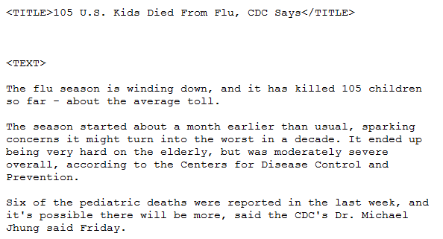
Data Sets and Preprocessing
Testing Set – 20 documents manually annotated.
Converted to tokens using our own preprocessor and supplied to CRF Classifier.

Slide 10
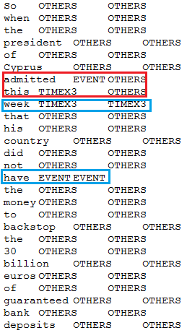
Evaluation Method
Word Actual Classification
Token-wise evaluation (not “strict” like the TempEval3 validator).
We provide true annotated token files to the Stanford NER CRF Classifier to test it against our trained model.
Stanford CRF Classifier compares its predictions to the true annotations and computes all relevant statistics for 3 classes.
Events
TimeX3
Others

Slide 11
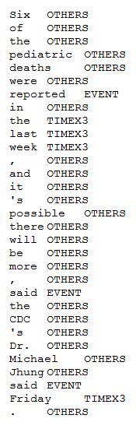
Sample Output & Statistics
Entity | P | R | F1 | TP | FP | FN
Event | 0.8115 | 0.7715 | 0.7910 | 1128 | 262 | 334
Other | 0.5999 | 0.5532 | 0.5756 | 952 | 635 | 769
TimeX3 | 0.9378 | 0.7101 | 0.8082 | 196 | 13 | 80
Total | 0.7144 | 0.6580 | 0.6850 | 2276 | 910 | 1183

Slide 12
Common Instances of TP, FP, FN
TIME EXPRESSIONS
EVENTS
TP
Friday | TIMEX3 | TIMEX3 | TRUE
last | TIMEX3 | TIMEX3 | TRUE
May | TIMEX3 | TIMEX3 | TRUE
last | TIMEX3 | TIMEX3 | TRUE
year | TIMEX3 | TIMEX3 | TRUE
week | TIMEX3 | TIMEX3 | TRUE
FN
2010 | TIMEX3 | OTHERS | FALSE
2008 | TIMEX3 | OTHERS | FALSE
eight | TIMEX3 | OTHERS | FALSE
years | TIMEX3 | OTHERS | FALSE
now | TIMEX3 | OTHERS | FALSE
FP
. | OTHERS | TIMEX3 | FALSE
TP
accepted | EVENT | EVENT | TRUE
negotiations | EVENT | EVENT | TRUE
FP/FN
compared | OTHERS | EVENT |  | FALSE
havoc | EVENT | OTHERS |  | FALSE
FP/FN
required | OTHERS | EVENT |  | FALSE
bailout | EVENT | OTHERS |  | FALSE

Slide 13
Variations in Training Set Size
For 10:
Entity | P | R | F1 | TP | FP | FN
EVENT | 0.7929 | 0.2435 | 0.3726 | 356 | 93 | 1106
OTHERS | 0.2202 | 0.0633 | 0.0984 | 109 | 386 | 1612
TIMEX3 | 0.875 | 0.1014 | 0.1818 | 28 | 4 | 248
Totals | 0.5051 | 0.1425 | 0.2223 | 493 | 483 | 296
For 500:
Entity | P | R | F1 | TP | FP | FN
EVENT | 0.8094 | 0.7202 | 0.7622 | 1053 | 248 | 409
OTHERS | 0.5774 | 0.5009 | 0.5364 | 862 | 631 | 859
TIMEX3 | 0.949 | 0.6739 | 0.7881 | 186 | 10 | 90
Totals | 0.7027 | 0.6074 | 0.6516 | 2101 | 889 | 1358
For 50:
Entity | P | R | F1 | TP | FP | FN
EVENT | 0.7904 | 0.5157 | 0.6242 | 754 | 200 | 708
OTHERS | 0.4246 | 0.2766 | 0.335 | 476 | 645 | 1245
TIMEX3 | 0.8882 | 0.5181 | 0.6545 | 143 | 18 | 133
Totals | 0.614 | 0.3969 | 0.4822 | 1373 | 863 | 2086
For 1000:
Entity | P | R | F1 | TP | FP | FN
EVENT | 0.8144 | 0.7442 | 0.7777 | 1088 | 248 | 374
OTHERS | 0.5944 | 0.5288 | 0.5597 | 910 | 621 | 811
TIMEX3 | 0.9261 | 0.6812 | 0.785 | 188 | 15 | 88
Totals | 0.7121 | 0.632 | 0.6696 | 2186 | 884 | 1273
For 100:
Entity | P | R | F1 | TP | FP | FN
EVENT | 0.793 | 0.5923 | 0.6782 | 866 | 226 | 596
OTHERS | 0.468 | 0.3481 | 0.3992 | 599 | 681 | 1122
TIMEX3 | 0.8866 | 0.6232 | 0.7319 | 172 | 22 | 104
Totals | 0.638 | 0.4733 | 0.5434 | 1637 | 929 | 1822
For 1500:
Entity | P | R | F1 | TP | FP | FN
EVENT | 0.809 | 0.7592 | 0.7833 | 1110 | 262 | 352
OTHERS | 0.6045 | 0.5497 | 0.5758 | 946 | 619 | 775
TIMEX3 | 0.9561 | 0.7101 | 0.815 | 196 | 9 | 80
Totals | 0.7167 | 0.6511 | 0.6823 | 2252 | 890 | 1207
For 200:
Entity | P | R | F1 | TP | FP | FN
EVENT | 0.804 | 0.6676 | 0.7294 | 976 | 238 | 486
OTHERS | 0.5351 | 0.4346 | 0.4796 | 748 | 650 | 973
TIMEX3 | 0.9362 | 0.6377 | 0.7586 | 176 | 12 | 100
Totals | 0.6786 | 0.5493 | 0.6071 | 1900 | 900 | 1559
For 2000:
Entity | P | R | F1 | TP | FP | FN
EVENT | 0.8067 | 0.7538 | 0.7793 | 1102 | 264 | 360
OTHERS | 0.5959 | 0.5415 | 0.5674 | 932 | 632 | 789
TIMEX3 | 0.9429 | 0.7174 | 0.8148 | 198 | 12 | 78
Totals | 0.7108 | 0.6453 | 0.6765 | 2232 | 908 | 1227

Slide 14

Graphs – Precision, Recall, F-Measure

Slide 15

Graphs – TP, FP, FN

Slide 16
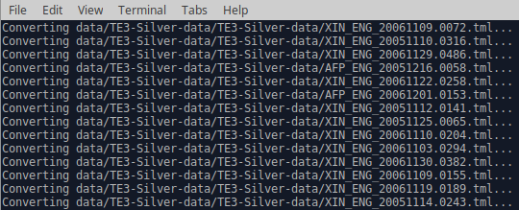
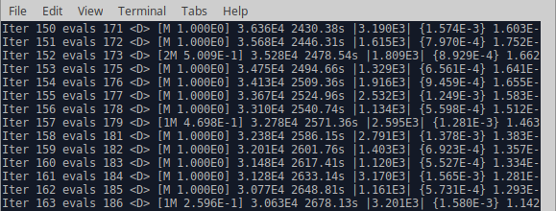
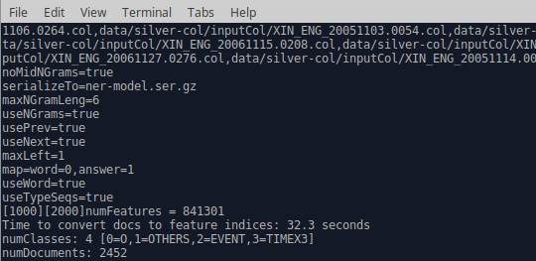
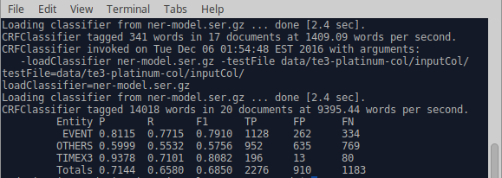
Sample Run
python control.py -pre_train_skip -train_skip -test_skip –train_n <number>
Preprocessing
Training
Testing
Feature Extraction

Slide 17
Performance Comparison to Clinical Domain
Results Obtained from : Hitachi at SemEval-2016 Task 12: A Hybrid Approach for Temporal Information Extraction from Clinical Notes - Sarath P R, Manikandan R, Yoshiki Niwa
Results Obtained from : CDE-IIITH at SemEval-2016 Task 12: Extraction of Temporal Information from Clinical documents using Machine Learning techniques - Veera Raghavendra Chikka
TimeX3 | P | R | F
Clinical | 0.821 | 0.669 | 0.737
Ours | 0.9378 | 0.7101 | 0.8082
Event | P | R | F
Clinical | 0.835 | 0.797 | 0.815
Ours | 0.8115 | 0.7715 | 0.791

Slide 18
Conclusions & Key Findings
We integrated state-of-the-art Stanford NER system to work on the tempEval3 dataset news domain using general CRF classifier
We performed an in-depth quantitative & qualitative analysis of the results for the Time & Event Extraction Tasks (TS and ES)
The size of the training set affected FN (accepted more expressions) following a logarithmic decrease which is a mirror to the logarithmic increase in TP!
The TP decrease although much slower followed to decrease with the increase in the Training Set size.
The news domain was more conducive to the general CRF classifers in extraction of temporal information. - The news domain has more absolute expressions than the clinical domain! -
The Clinical domain was better in the event extraction task due to the higher density of events and procedures as seen in such Corpora.

Slide 19
Future Work
Normalization of values to the Identified temporal expressions.
Identifying container relations between temporal and event expressions.
Concentrate on the Duration Attribute of Temporal Expressions exploring novel ML techniques
Open source our software under the GNU license.
Sutton and McCallum suggest in A survey on Conditional Random Fields that “using HMM with CRF's in a hybrid approach are theoretically proven to give better f-measure values for the sequential Named Entity Recognition task” – We want to explore this line of thought as well!

Slide 20
Bibliography
A Cascaded Machine Learning Approach to Interpreting Temporal Expressions - David Ahn Joris van Rantwijk Maarten de Rijke
An Introduction to Conditional Random Fields - Charles Sutton and Andrew McCallum
Temporal Tagging on Different Domains: Challenges, Strategies, and Gold Standards -Jannik Str¨otgen, Michael Gertz
Machine Learning Approaches for Temporal Information Extraction: A Comparative Study - Oleksandr Kolomiyets, Marie-Francine Moens
Hitachi at SemEval-2016 Task 12: A Hybrid Approach for Temporal Information Extraction from Clinical Notes - Sarath P R1, Manikandan R1, Yoshiki Niwa2
CDE-IIITH at SemEval-2016 Task 12: Extraction of Temporal Information from Clinical documents using Machine Learning techniques - Veera Raghavendra Chikka
TempEval-3: Evaluating Events, Time Expressions, and Temporal Relations - Naushad UzZaman, Hector Llorensy, James Allen, Leon Derczynskiz, Marc Verhagen and James Pustejovsky
A Corpus of Clinical Narratives Annotated with Temporal Information - Lucian Galescu Nate Blaylock
Discovering Narrative Containers in Clinical Text - Timothy A. Miller1, Steven Bethard2, Dmitriy Dligach1, Sameer Pradhan1, Chen Lin1, and Guergana K. Savova1

Slide 21
Thank You
Presented by Ankush Israney & Jaidev Ramakrishna for CS 613

